Slide 1
Encryption of communication using Face Detection and Eye Tracking using Morse Code
St. John College of Engineering and Management
Presented by:
Manasvi Kotian 1162066
Brandon Rodrigues 1162026
Nihar Vaidya 1162022
Guided by:
Mr. Rashmi Bhat

Slide 2
Contents:
Abstract
Introduction to Domain
Problem Definition
Proposed System
Objectives
Scope
Literature Survey
Requirement Analysis
System Architecture
System Design
Conclusion
Future Scope
References

Slide 3
Abstract:
In computer science, digital image processing is the use of computer algorithms to perform image processing on digital images. The main goal of our project to create a platform for communication between individuals. The platform on which the user can communicate has to be a secure channel, and the method in which the message is be send and received is also not though regular text format. It is been sent through Morse code. Morse Code is a binary language which consists of ‘1’ and ‘0’, the combination of these ‘1’ and ‘0’ form all the alphabets. The user sends the secret information in Morse code language via blinking his/her eyes. A normal blink refers to a ‘0’ and a long blink refers to a ‘1’. If the user keeps his/her eyes open for a long period of time, It is to display the one alphabet is been completed. The application can work in three ways i.e. any video that is been played, a live person via a camera,a 2-way communication between two users and to send a receive the Morse code data.

Slide 4
Introduction to Domain:
Digital image processing
The digital image processing deals with developing a digital system that performs operations on an digital image.
It is the use of computer algorithms to create, process, communicate, and display digital images.
It can be used to convert signals from an image sensor into digital images,improve clarity, and remove noise and other artifacts,extract the size, scale, or number of objects in a scene,prepare images for display or printing, compress images for communication across a network.

Slide 5
Problem Statement:
The main goal for the development of this project is to prove the users of this application with an interface to communicate with each other. In regular text messengers the text data can be intercepted by the attacker to gain the knowledge. With the help of sending data via Morse code the leakage of data is been reduced. Apart from communicating with an individual this application helps in detecting faces among people and then decrypting the messages sent by them. The final objective of the project is to help doctors an the relatives to have a proper communication with patients who are unable to speak or communicate in a proper manner.

Slide 6
Proposed System:
The project creates a human interaction system in which the user can communicate via eye blink to convey any secret message. The way it performs the task is by measuring the duration of each blink .
The system would first detect the face and then determine the location of the eyes. Once eyes has been detected, it works on counting the blinks.
Each alphabet is been represented by a different combination of blinks i.e. short blink(0) and long blink(1) .
To distinguish two alphabets the system would check if the eyes are opened for a specific duration of time.

Slide 7
Objectives:
To get the input video and recording from the user.
To perform face detection and eye blinding monitoring procedure.
To extract the Morse code from the blinking.
To convert the blinks in to proper alphabets and blinks.
To create a project on our own unique code
To display the secret message.

Slide 8
Scope:
To help individual to communicate secretly.
To provide a better platform for a unique method of communication in which the text messages cannot be detected.
To create an interface for the patients to communicate with the doctors and their close ones.

Slide 9
Literature Survey I :
[1] Morse code-based communication system focused on amyotrophic lateral sclerosis patients
This application is based on face recognition and facial features techniques to extract Interest by applying filters and cascade classifier with OpenCV implemented in Visual Studio. Likewise, a software program was developed to transform blinkings into words, along with a graphical user interface; the ALS patient has the possibility to structure sentences, thus, facilitating his/her communication process with relatives and medical staff.

Slide 10
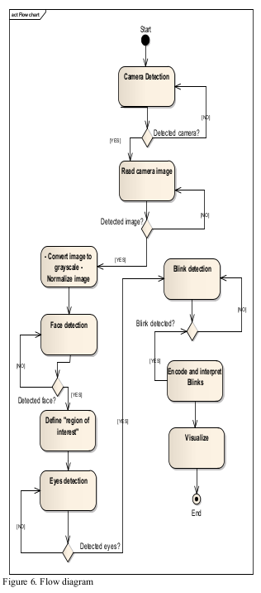
System Architecture:

Slide 11
Advantages:
Auto completion of words
Use of assistant
Disadvantages:
No Two way communication
Low Security
Use of an external agent

Slide 12
Literature Survey II :
[2] Human computer interaction by eye blinking on real time.
There are a lot of disabled people who can't control some parts of their bodies such as ALS and real time human – computer interaction systems can help them. In this paper, a real time vision system is presented to provide a communication way to people has severe disabilities. Patients will be able to choose words on an alphabet tree which is designed on a binary tree by blinking right and left eye, thus they will make sentences.

Slide 13
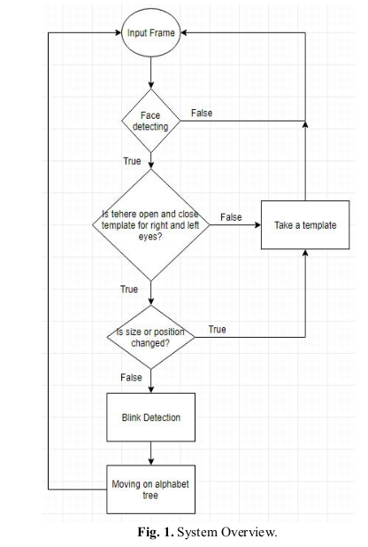
System Architecture:

Slide 14
Advantages:
Easy to use
Helpful for patients
Disadvantages:
Limited scope of communication
Inefficient eye tracking
No two way communication

Slide 15
Literature Survey III :
[3] Driver Fatigue Detection Based on Eye Tracking and Dynamic’ Template Matching
A vision-based real-time driver fatigue detection system is proposed for driving safely. The driver’s face is located, from color images captured in a car, by using the characteristic of skin colors. Then, edge detection is used to locate the regions of eyes. In addition to being used as the &namic templates for eye tracking in the next frame, the obtained eyes’ images are also used for fatigue detection in order to generate some warning alarms for driving safety.

Slide 16
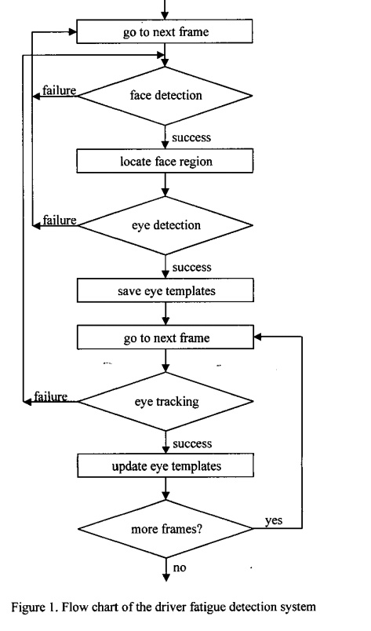
System Architecture:

Slide 17
Advantages:
Accident prevention
Faster execution
Disadvantages:
Hard to detect face at night
Good quality of camera is required
Installation is complicated

Slide 18
Requirement Analysis:
Functional Requirements:
The application should be able to play videos and detect faces in them, once detected select one specific face.
The project should be able to take live input from the camera and do the same.
Once a face is detected, it should track the eyes and count the blinks to determine the Morse code sequence.
Once the sequence is been found, it must convert them into words and strings and then display them.

Slide 19
Requirement Analysis:
Non-Functional Requirements:
The process of selecting the face form the detected face in the given video must be simple.
The words found from the System must be checked to remove any errors.
The use of this application must know the Morse code language to use it, and communicate with the system.

Slide 20
Requirement Analysis:
Hardware Requirements
35 GB HDD storage
8 GB RAM
i5 7th gen and above
GTX 750ti and above
Inbuilt camera in laptop
External Webcam for desktop

Slide 21
Requirement Analysis:
Software Requirements:
Python 3
openCV

Slide 22
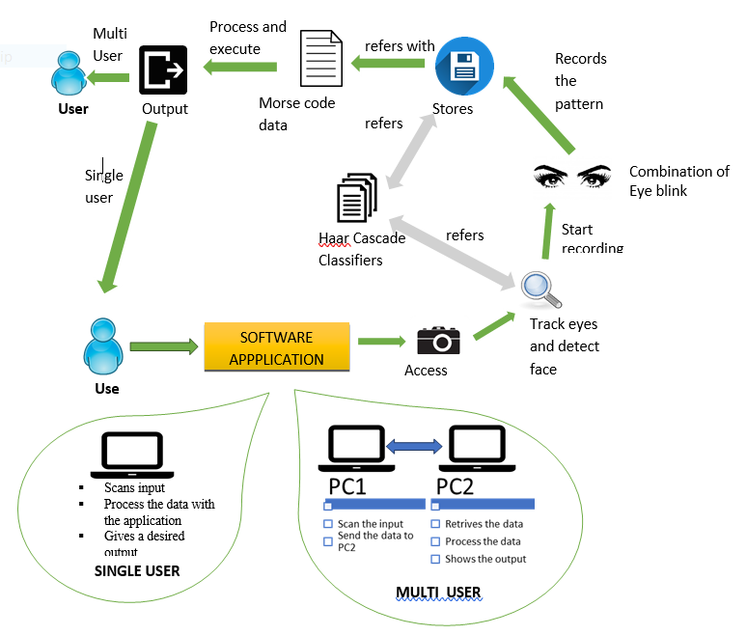
System Architecture:

Slide 23
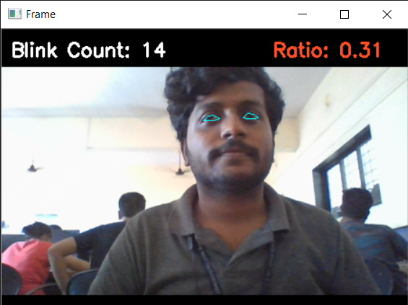
Implementation
The system is able to detect the eyes, and the ratio of the points associated with it.
When the ratio falls under 0.25 the system counts as a blink.

Slide 24
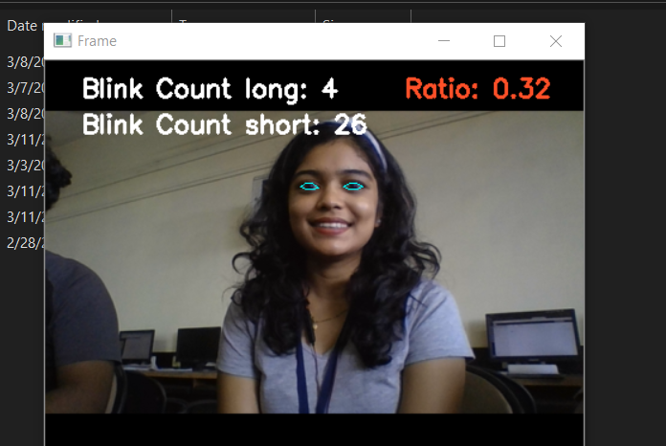
Implementation
Further the system is able to detect short and long blinks.
It counts the no. of frames for which the user’s eye ratio falls below the threshold.

Slide 25
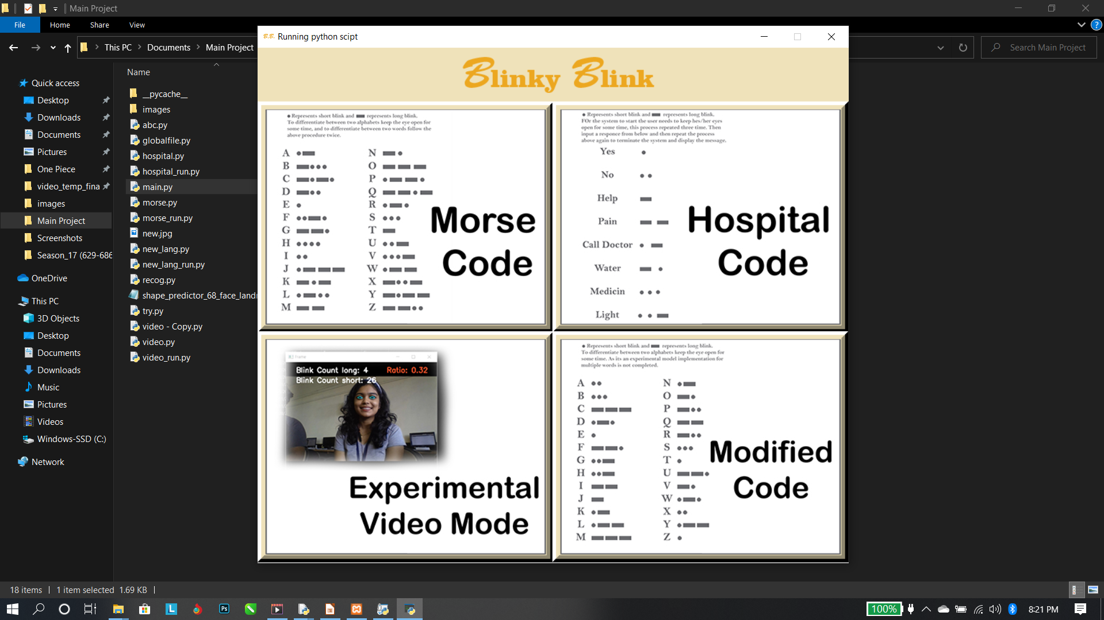
Execution:
Main page:
This page allows the user to select one between the four choices as shown.

Slide 26
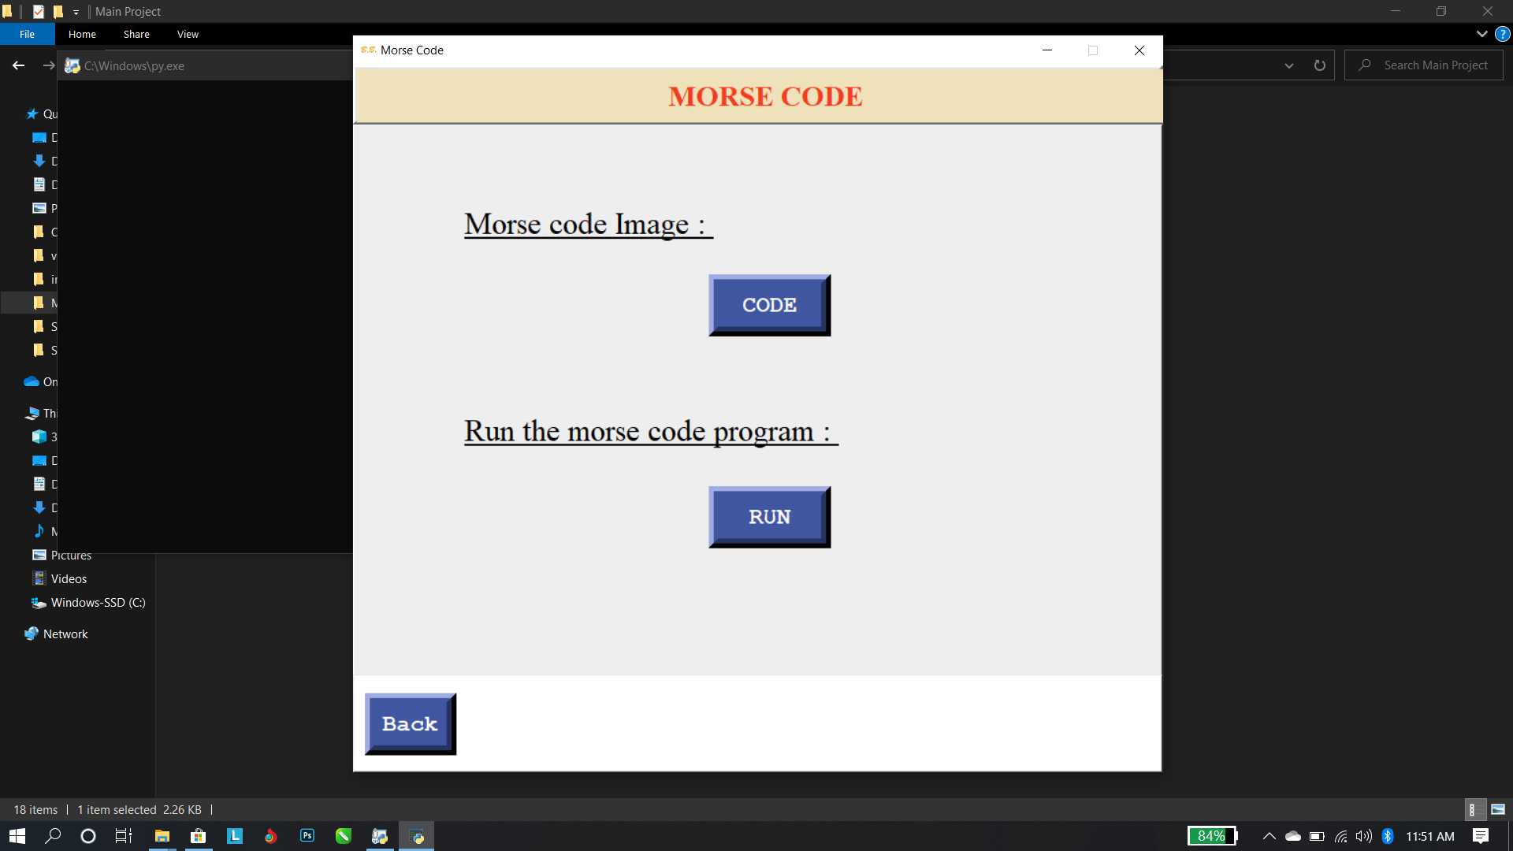
Morse code page:
This page allows the user to see the morse code (universal) and/or to run the the program that fill function the eye blink with respect to the morse code combinations

Slide 27
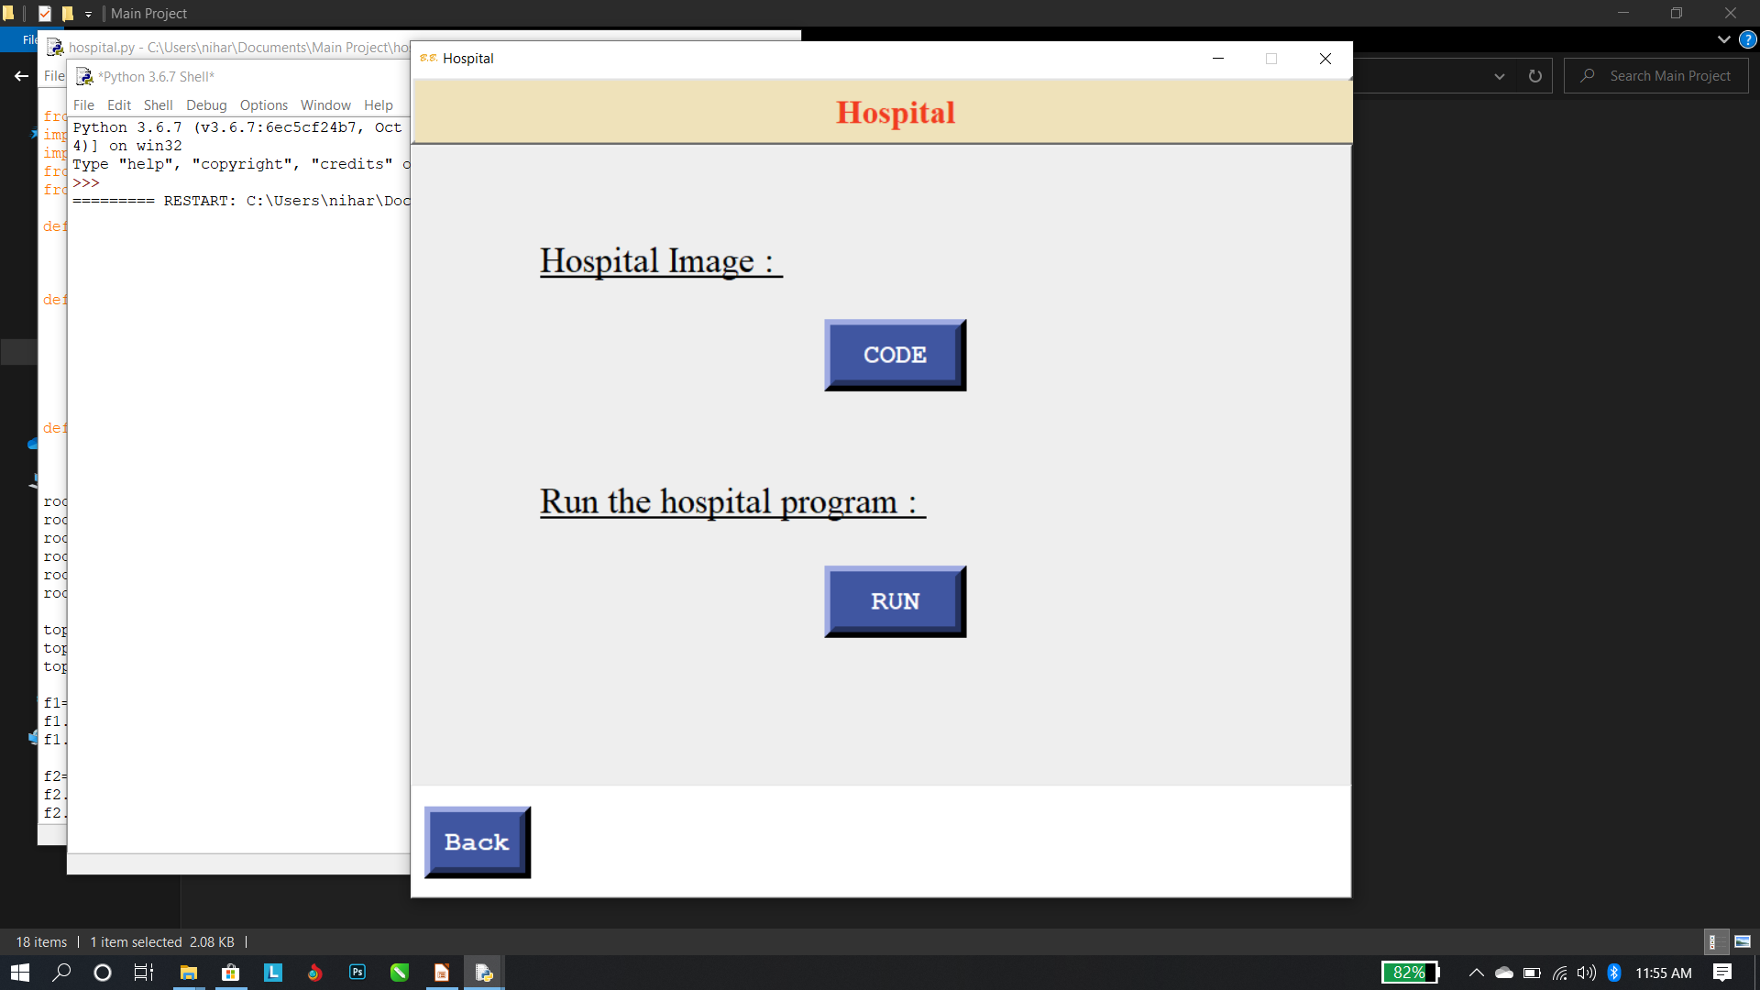
Hospital page:
This page allows the user to see the code that is assigned for the hospitals in the form of ‘ . ’ and ‘ _ ’ . It also provides the button the run the program with respect to the above mention code .

Slide 28
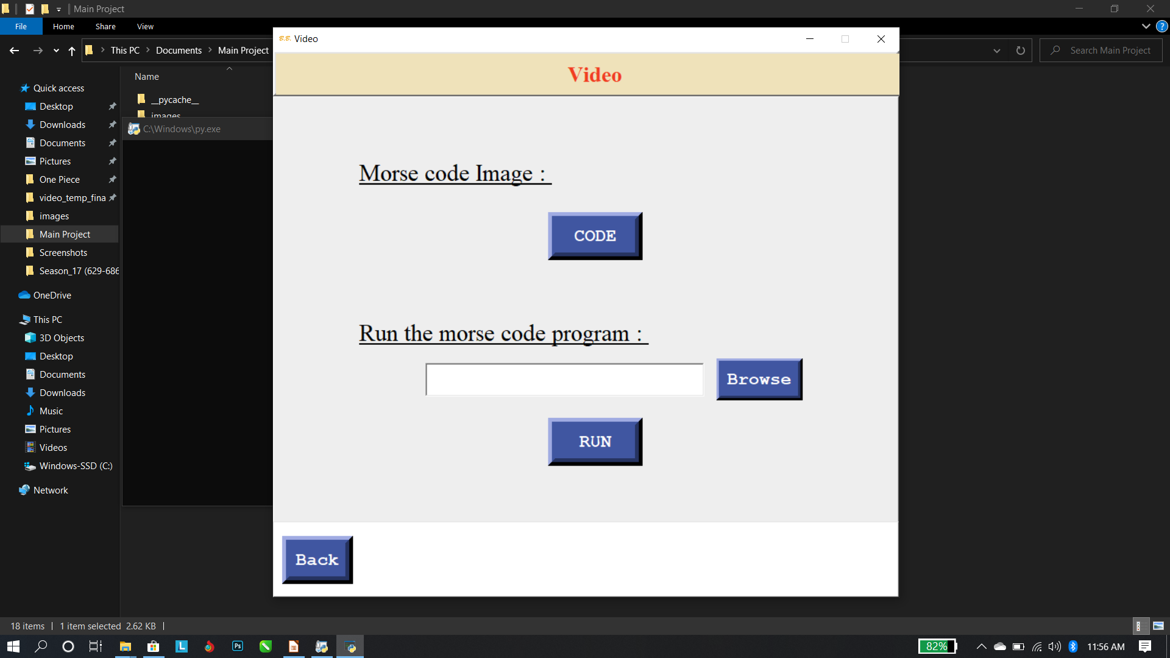
Video page:
This page allows the user to see the morse code (universal) . It requires the import video to run and process the program on it so that to get the output of the blinks presented in that video.

Slide 29
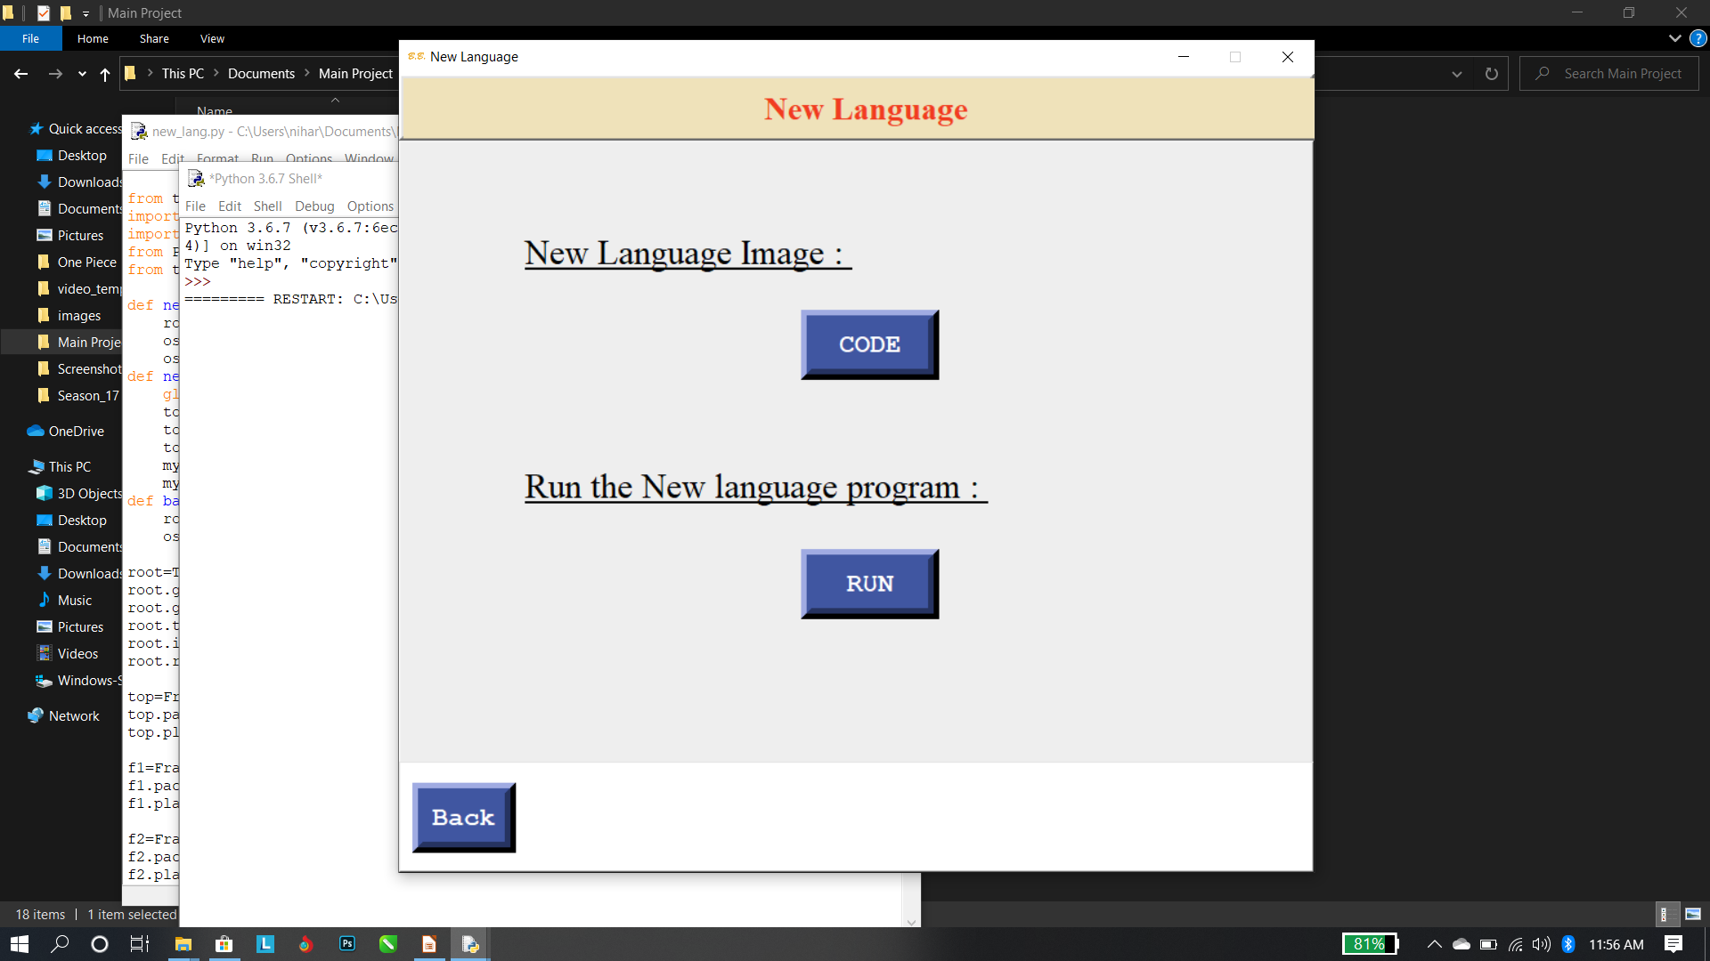
New language page:
This page is for a custom made code of us. It allows to view our unique code and to allow to run program to take the inputof the eye blinks combination and shiw us the output.

Slide 30
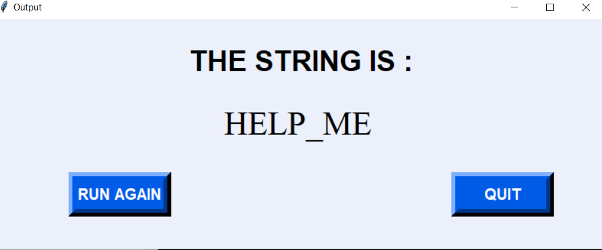
Output:

Slide 31
Future Scope:
Real time face detection for creating a vault for the user where he/she can store the confidential data in with the two way authentication (face recognisation and eye blinks to store a pattern)
Two way communication between two users where they can communicate through eye blinks

Slide 32
References:
[1] J. Garry and K. Casey, “Psychosocial Impact of the Tobii C12 Eye Tracking Computer in the ICU Setting.,” Crit. Care Med., vol. 41, no. 12, 2013.
[2] M. Betke and W.J. Mullally, “Preliminary Investigation of Real-Time Monitoring of a Driver in City Traffic,” Proceedings of the IEEE International Conference on Intelligent Vehicles, Dearhorn, MI, pp. 563-568, October 2000.
[3] M. Eriksson and N. Papankolopoulos, “EyeTracking for Detection of Driver Fatigue,” 11 Proceedings of the International Conference on Intelligent Transportation Systems, Boston, MA, pp. 3 14-3 19, November 1997.

